Slide 1
Introduction to SharePoint
By Arun Sahoo
Microsoft Certified Professional - SharePoint

Slide 2
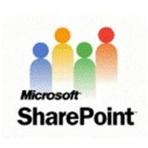

What Is SharePoint?
SharePoint is a web-based collaborative platform that integrates with Microsoft Office. Launched in 2001, SharePoint is primarily sold as a document management and storage system, but the product is highly configurable and usage varies substantially among organizations.
SharePoint is available in 3 main ways or “Types of Platforms”:
On Premise (Standard & Enterprise)
In the cloud (online, servers are managed by Microsoft)
Hybrid (both On Premise and online)
License based product→ regardless of the “type” of platform you choose your licenses will determine what you can do on your platform.

Slide 3
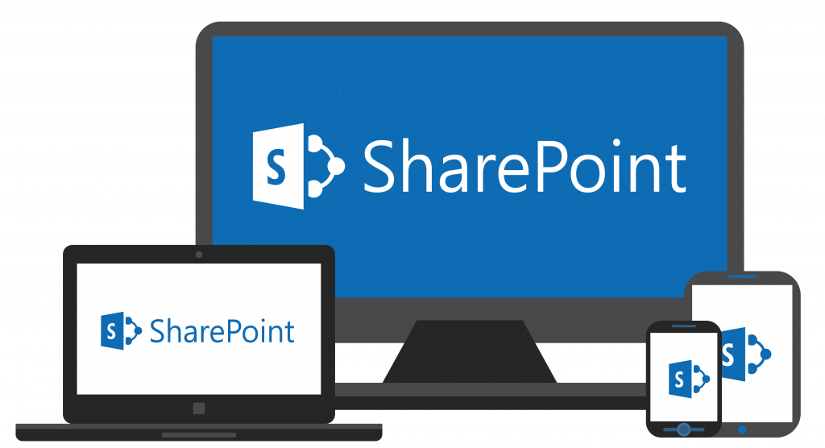
What Are the Benefits of Using SharePoint?
SharePoint has been integral in the past 17 years in increasing working efficiency in fortune 500 companies as an “Intranet” platform that crosses all business sectors. The many features of the platform make it much easier for people to work together on ad-hoc projects and establish standard business processes for information sharing, document publishing, and recording data.
Features like security controls, co-authoring, versioning, and integration with Exchange (Outlook Email Applications) give business users the capability to do more in less time and maintain the integrity of the work they produce. SharePoint includes the ability to:
Require an approval on documents before they are visible
“Check out” documents to prevent any other authoring or editing on them
Get notifications when documents are uploaded or changes are made
Make workflows using if/then logic to automate actions such as moving or emailing documents, and recording information

Slide 4
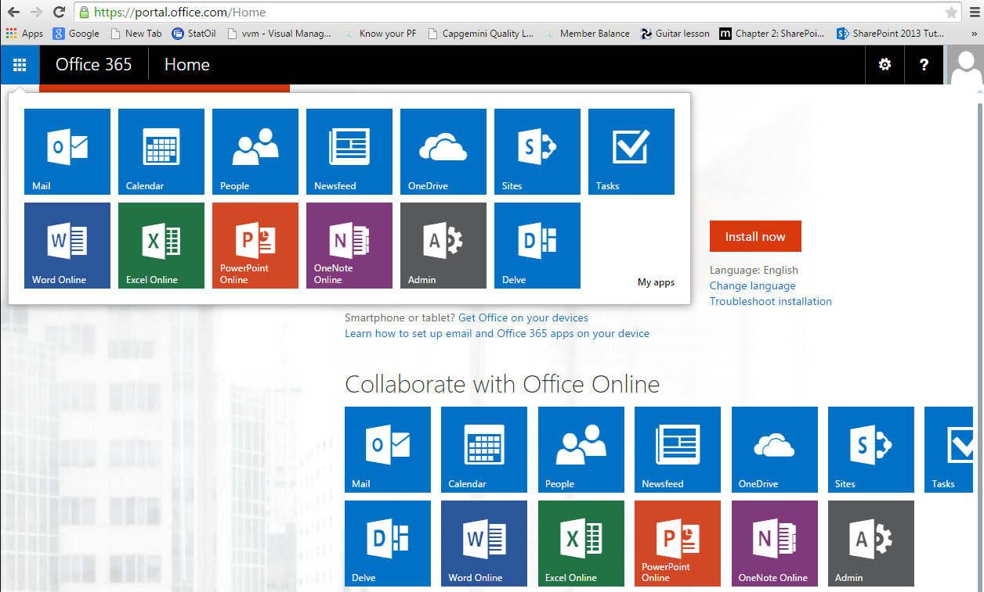
SharePoint Online/Cloud

Slide 5
Which SharePoint is right for you?
 | On Premise (on site) | Online (in the Cloud) | Hybrid (Best of Both Worlds)
Highlights | Full Customization* Robust Security and Confidentiality High Data Integrity | Much Less Management High Availability Less cost Does not Require an IT Team | Pick and Choose what fits your needs.
Use If: | You require customization You are concerned with Compliance and legal restrictions. Data Integrity is a concern | You don’t have dedicated IT personnel Don’t have a large IT budget Using out of box solutions to meet your needs | Pick and Choose what fits your needs.
Do Not Use if: | No dedicated IT Team Have the funds for 3rd party support if no In house IT. Don’t have a very large budget! | You have to adhere to heavy Compliance Regulations or other legal restrictions If you want/need to Customize- customization is not available | You don’t have an IT Team dedicated to managing the server(s).
A note about Customization vs Configuration
Customization involves changing the code of the SharePoint to change or extend functionality.
Configuration modifying pre-existing tools or apps using the built in tool sets

Slide 6
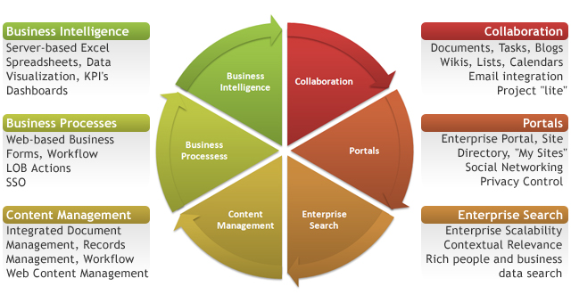
What can I use SharePoint for?
Regardless of whether your organization uses SharePoint Online, On Premise or Hybrid, SharePoint gives you the tools to manage your business processes in one place.
Image Source: http://computertrainingcenters.com/10-ways-sharepoint-can-help-your-business

Slide 7
SharePoint Architecture High Level View
Site Collection
Site
Pages
Apps, Web Parts
Subsite
Pages
Apps, Web Parts
Apps, Web Parts
Apps, Web Parts
Web Application
Web Application: Top level Web App at IIS level
Site Collection: Root of your Sites
Site: Your Main Team Site or Function Site
Subsite: Additional Subject sites below your Team Site or Function Site
Pages: Project pages or subject pages that don’t need to be sites or subsites
Apps and Web Parts: These are your out of box solutions.
i.e. Calendar, Document Library, Task Lists

Slide 8
Out of Box Solution: The Document Library
Most people use a document library to simply store documents. In SharePoint, you can use it to do so much more! For example, Oaw uses a document library to keep track of the status of our current projects and tasks, as well as to grant visibility to the office of the status of our work.
Ways you can Modify and/or use a Document Library (other than storing documents)
Add Columns to display certain metadata
Add Work Flows for automated Notifications and Approvals
Create different “views” to display certain information (like a dashboard)
Assign tasks and link them outlook for individuals
Assign record policies
Store sets of documents with specific sets of metadata assigned to them (cannot do this with folders)

Slide 9
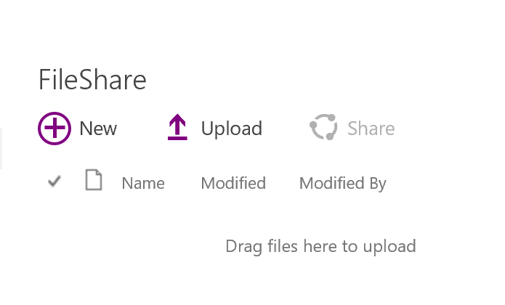
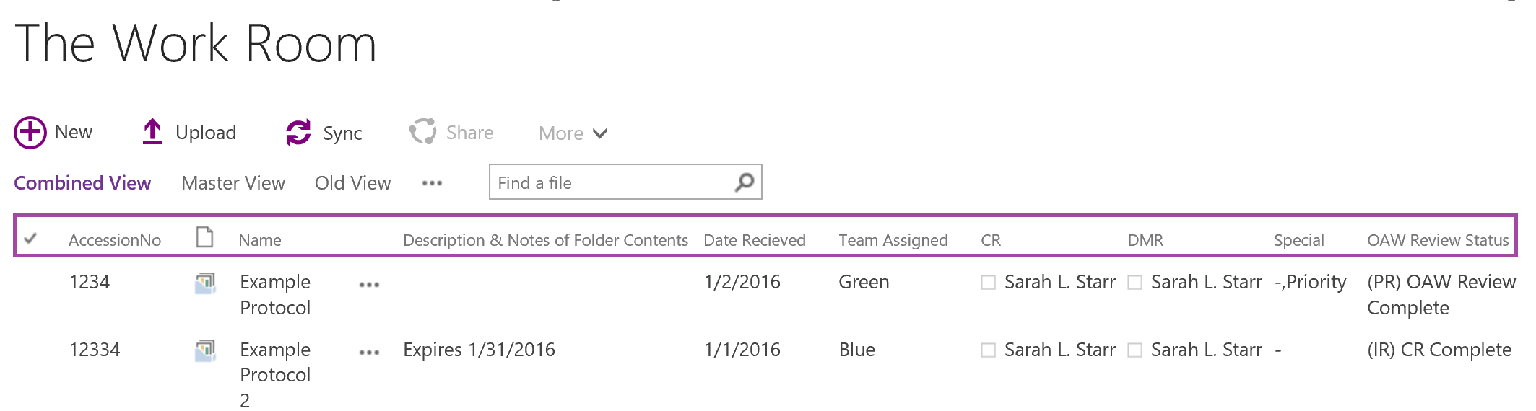
Example of a Modified Document Library
This is What a document library looks like when you add it to a page:
Below is what The Work Room modified Document library looks like. This library has custom metadata, columns, workflows, document sets and custom views.
These are all custom columns.

Slide 10
Out of Box Solution: Modified List
Lists are very similar to document libraries in terms of what you can do with them. The difference is that instead of working with documents or “files” you are working with “data”.
Ways you can Modify and/or use a List
Add Columns to display certain metadata
Add Work Flows for automated Notifications and Approvals
Create different “views” to display certain information (like a dashboard)
Assign tasks and link them outlook for individuals
Attach Files
Use in Business Intelligence

Slide 11
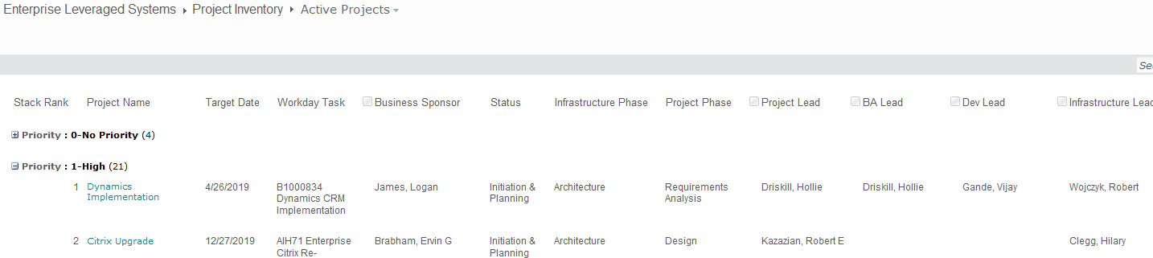
Example of A Modified list
How it works:
Individual creates a new agenda item, fills out the meeting and topic
Decision is recorded with the agenda item during the meeting
List is searchable by topic or meeting date (or other metadata value) so easy to look-up for reference.

Slide 12
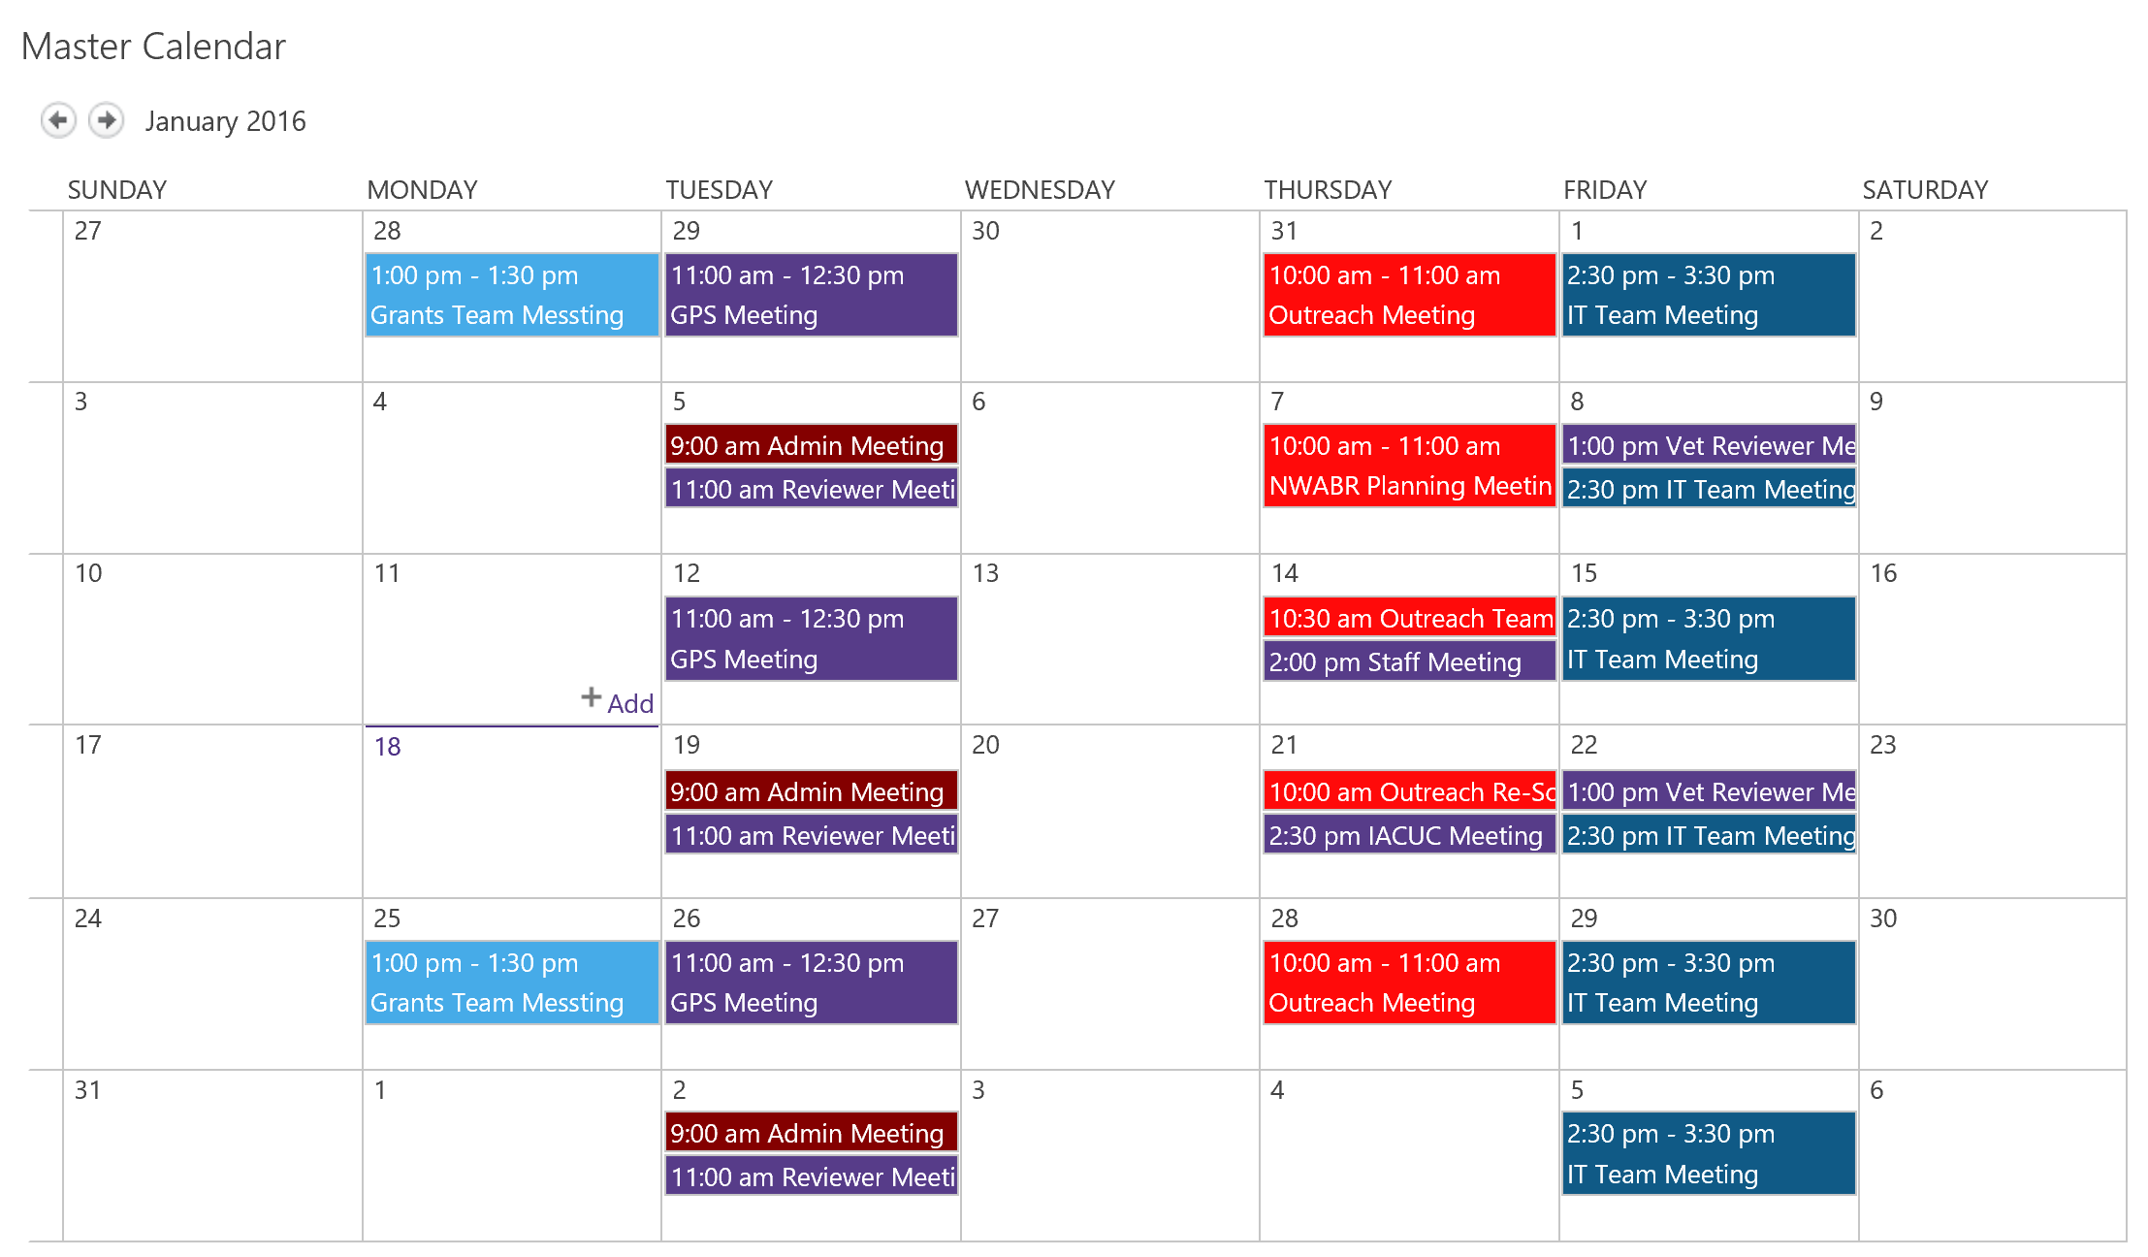
Out of Box Solution: Calendar
Great uses of Calendars in SharePoint include:
Project Calendars
Team Calendars
Out of Office/Leave Calendars
Office/Department Calendars
Features
Overlays- overlay up to 10 calendars in a single calendar view
Integrates with your outlook calendars
Custom views
Integrate with Tasks in SharePoint or in Outlook
Each color on the calendar represents a Team Calendar that has been overlayed on the Master Calendar

Slide 13
OneDrive for Business
OneDrive for Business is your personal online document library (1 terabyte of storage) , but you can also use it to explore the capabilities of SharePoint to see if SharePoint is right for your business needs:
Open your one Drive for Business
Go to Site Settings
Click on Site Contents
Click on +Subsite
Start playing around!

Slide 14
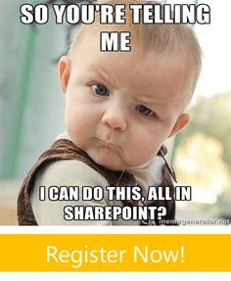
Thank you!

